Slide 1
Biosynthesis of Silver Nanoparticles Using Housefly Extract as a Bio-Resource and Evaluation of their Biomedical Properties
Mariyam Shafiq
Shaheed Zulfikar Ali Bhutto Institute of Science and Technology (SZABIST), Karachi, Pakistan

Slide 2
Research Problem
Limitations of Physical and Chemical Methods:
High financial and energy costs, Potential health risks (carcinogenicity, toxicity)*
Unsuitable for clinical, biomedical, and pharmaceutical applications (Hua et al., 2018)
1
Green Synthesis of metal NPs using an insect
RESEARCH
GAP
2
Characterization of M.domestica-induced NPs
3
Evaluation of Biomedical Properties of Md-NPs
*(Gour & Jain, 2019; Gupta & Xie, 2018; Singh et al., 2018)

Slide 3
Novelty & Innovation
Bioresource Utilization: Used housefly extract for nanoparticle synthesis, a pioneering approach
Chemical-Free Process: No additional chemicals were used for synthesis, showcasing the extract's natural potential.
Rapid Synthesis: Achieved nanoparticle formation within just 15 minutes

Slide 4
About Musca domestica (Housefly)
High aspect ratio nanoparticles include nanotubes and nanowires, with various shapes, such as helices, zigzags, belts, or perhaps nanowires with diameter that varies with length. Small-aspect ratio morphologies include spherical, oval, cubic, prism, helical, or pillar.03-Apr-2019
Model Organism:
Versatile, easy to handle organism
Short reproduction cycle and low-cost maintenance
Requires less space for cultivation, conservation, and preservation
Ethical Considerations:
Fewer ethical concerns compared to studies using animals such as, rodents
(Staats et al., 2018; Mirzoyan et al., 2019; Jennings, 2011)

Slide 5
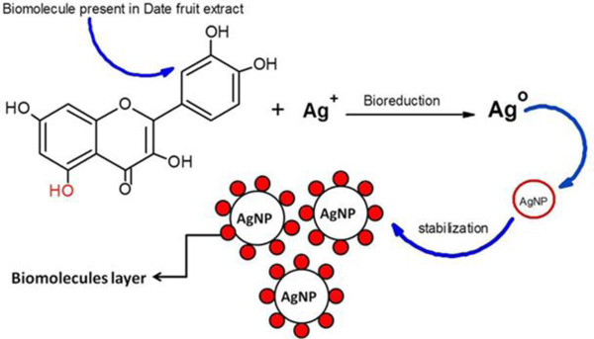
Bio-reduction Process
Mechanism: Transformation of metal ions to nanoparticles using biological materials.
Agents:
Enzymes: Facilitate reduction of ions
Biomolecules: Phenols, proteins, and reducing sugars stabilize NPs
Advantages:
Eco-friendly and sustainable
Enhanced biocompatibility
Source: Bio-reduction and stability of Ag-NPs using
date fruit extract (Zafar, 2019)
(Gambhir et al. , 2022; Jaradat et al., 2024; Thongnopkun et al., 2018)

Slide 6
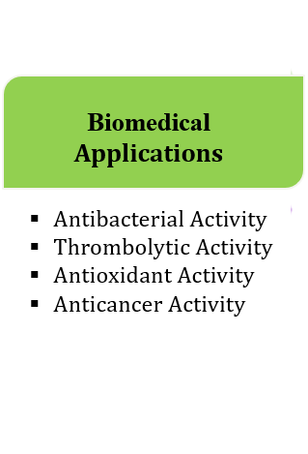
RESEARCH DESIGN
Research Design

Slide 7
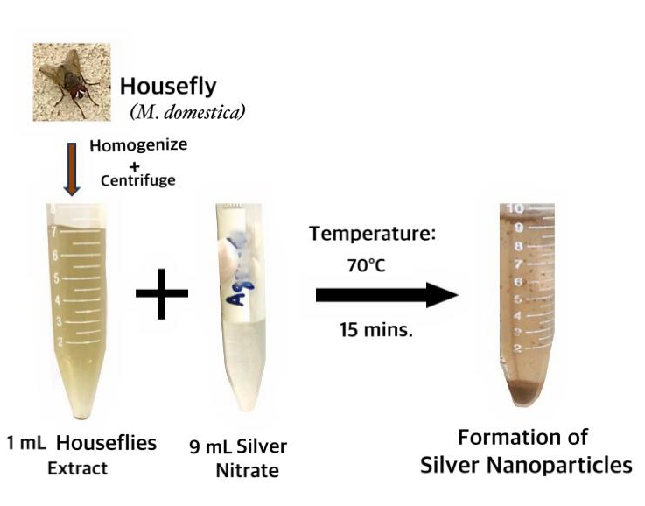
Biosynthesis of Silver Nanoparticles (Ag-NPs)
Methodology Overview:
Green Synthesis Steps:
Preparation: Extract from M. domestica, as a reducing agent
Reaction: Mixing with silver nitrate solution
Observation: Formation of brown precipitate indicating Ag-NPs

Slide 8
Overview of Biomedical Activities of Ag-NPs
Activity | Method/Assay | Test Substances | Procedure | Evaluation
Antibacterial Activity | Agar Well Diffusion Method | Staphylococcus aureus & Pseudomonas aeruginosa, Ag-NPs vs. Ciprofloxacin | Measure zones of inhibition against standard antibiotics (Subramaniam et al., 2020) | Compare inhibition zone diameters
Anticoagulant Activity | Thrombolytic Assay | Ag-NPs vs. Aspirin (control) | Clot lysis assessed using standard protocols (Barabadi et al., 2023) | Calculate thrombolysis percentage
Anticancer Activity | MTT Assay | HeLa cells (Cervical cancer) Ag-NPs vs. Doxorubicin | Incubate cells with Ag-NPs and controls, measure viability (Ugwu & Jeanet Conradie, 2023) | Calculate IC₅₀ for cell growth inhibition
Antioxidant Activity | DPPH & H₂O₂ Scavenging Assays | Ag-NPs vs. Vitmain C (control) | Incubate Ag-NPs and controls with DPPH and H₂O₂ solutions (Lalsangpuii et al., 2022) | Assess radical scavenging potential

Slide 9
Visual Confirmation
Results
Initial clear solution of silver nitrate
5 minutes after addition of extract and keeping in shaking water bath at 70°C,
15 minutes later where brown coloured colloid is evident.

Slide 10
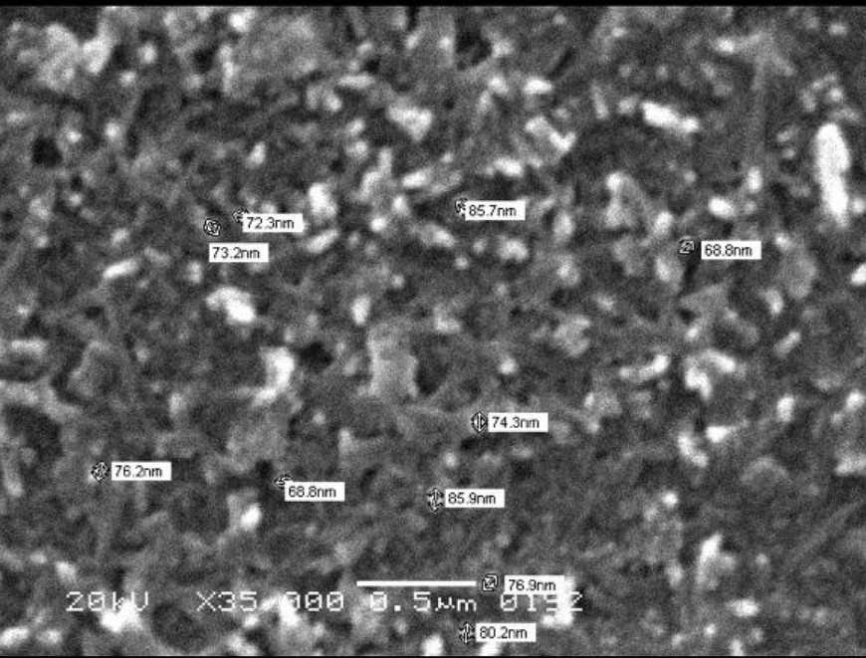
Optical & Morphological Characterization
SEM image of biosynthesized Ag-NPs
The SPR absorbance band at 475 nm for Ag-NPs synthesized using housefly extract.
Average Size: 76 ±6.13 nm
Polydispersity Index (PDI): 0.006

Slide 11
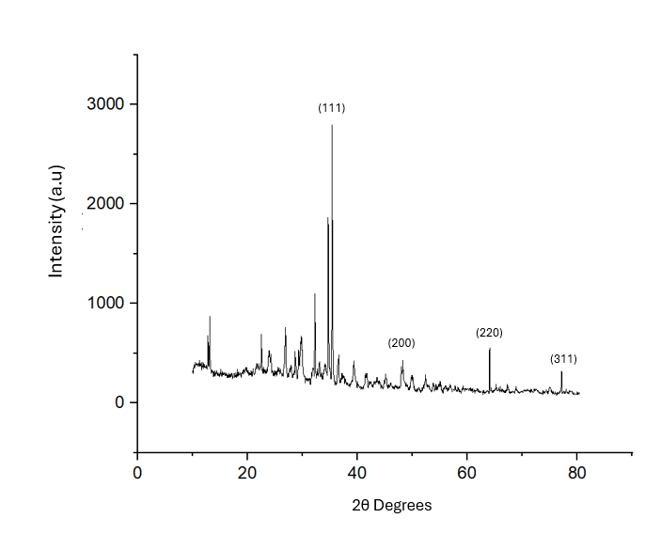
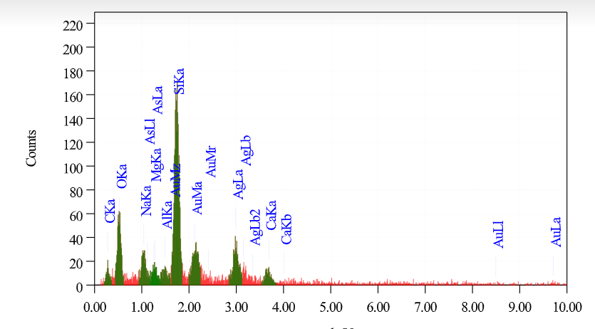
Structural & Elemental Characterization by XRD & EDX
Crystallite size: ~ 9.72 nm
Phase: Face-centered cubic (FCC)
Key Peaks: 38.1° (111), 44.3° (200), 64.4° (220), 77.3° (311)
JCPDS Card No. 04-0783
(Khan, M.J. et al., 2019)
XRD spectrum of biosynthesized Silver NPs in housefly extract
EDX spectrum of biosynthesized Silver NPs in housefly extract

Slide 12
Surface Characterization by FT-IR
(CH)
(C-N)
(C=O)
(C-N)
(C=O)
(O-H)
(O-H)
(Ag-NPs)

Slide 13
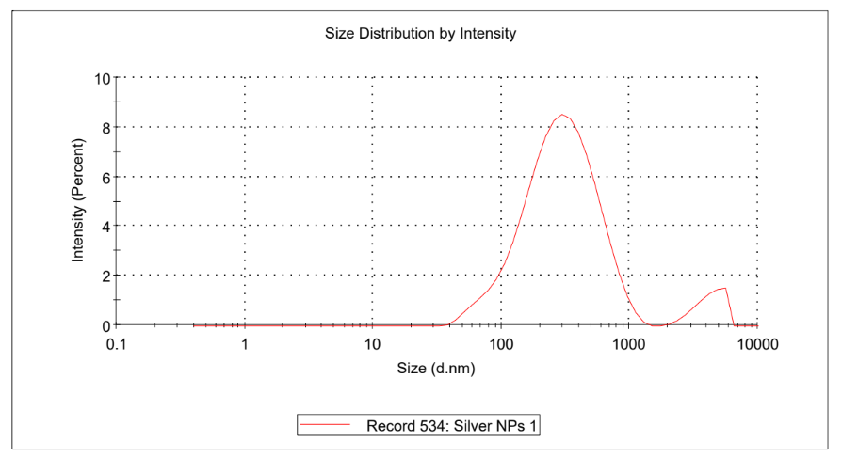
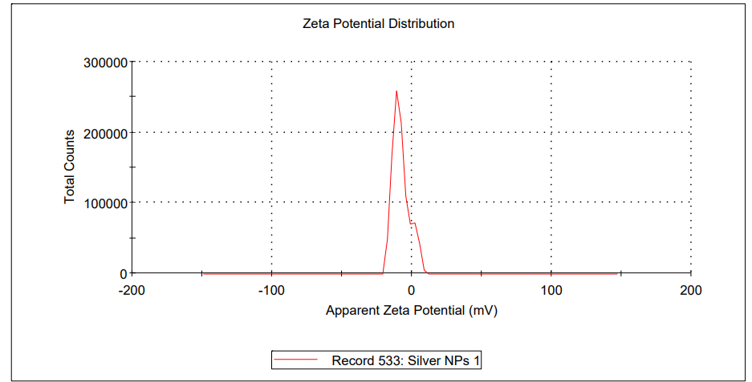
Hydrodynamic Size & Colloidal Stability Characterization
Zeta average size: 258.5 nm
PDI: 0.371
Quality: Good
Mean Zeta Potential: -7.98 mV
Zeta Deviation: 3.47 mV
Quality: Good

Slide 14
Summary of Results
Characterization:
UV-Vis Peak: 475 nm (Reddish-brown colloid)
SEM: Avg. Size: 76 nm; PDI: 0.006
XRD: Crystallite Size: ~9.72 nm, FCC Phase
Zeta Potential: -7.98 mV; Zeta Size: 258.5 nm (PDI: 0.371)
EDX: Strong Ag peak at 3 keV
FTIR Peaks: 3273 cm⁻¹ ;1637 cm⁻¹ (O-H,C=O stretching), 430 cm⁻¹ (Ag-NPs bands)
Biological Activities:
Antibacterial: Effective inhibition, surpassing antibiotics
Anticoagulant: Thrombolysis rate: 54.23% (similar to aspirin)
Anticancer: 96.13% inhibition against HeLa cells
Antioxidant: High scavenging activity: 67.17% (H₂O₂), 78.5% (DPPH)

Slide 15
REFERENCES
REFERENCES
Lalsangpuii, F., Rokhum, S. L., Nghakliana, F., Fakawmi, L., Ruatpuia, J. V. L., Laltlanmawii, E., Lalfakzuala, R., & Siama, Z. (2022). Green Synthesis of Silver Nanoparticles Using Spilanthes acmella Leaf Extract and its Antioxidant-Mediated Ameliorative Activity against Doxorubicin-Induced Toxicity in Dalton’s Lymphoma Ascites (DLA)-Bearing Mice. ACS Omega, 7(48), 44346–44359. https://doi.org/10.1021/acsomega.2c05970
Mirzoyan, Z., Sollazzo, M., Allocca, M., Valenza, A., Grifoni, D., & Bellosta, P. (2019). Drosophila melanogaster: A Model Organism to Study Cancer. Frontiers in Genetics, 10. https://doi.org/10.3389/fgene.2019.00051
Singh, J., Dutta, T., Kim, K., Rawat, M., Samddar, P., & Kumar, P. (2018). ‘Green’ synthesis of metals and their oxide nanoparticles: applications for environmental remediation. Journal of Nanobiotechnology, 16(1). https://doi.org/10.1186/s12951-018-0408-4
Staats, S., Lüersen, K., Wagner, A., & Rimbach, G. (2018). Drosophila melanogaster as a Versatile Model Organism in Food and Nutrition Research. Journal of Agricultural and Food Chemistry, 66(15), 3737-3753. https://doi.org/10.1021/acs.jafc.7b05900
Subramaniam, G., Yew, X. Y., & Sivasamugham, L. A. (2020). Antibacterial activity of Cymbopogon citratus against clinically important bacteria. South African Journal of Chemical Engineering, 34, 26–30. https://doi.org/10.1016/j.sajce.2020.05.010
Thongnopkun, P., Jamkratoke, M. and Jitkam, Y. (2018) ‘Green synthesis and characterization of silver nanoparticle using natural reducing sugar from cultivated banana peel’, Journal of Physics: Conference Series, 1144, p. 012159. doi:10.1088/1742-6596/1144/1/012159.
Ugwu, D. I., & Jeanet Conradie. (2023). Anticancer properties of complexes derived from bidentate ligands. Journal of Inorganic Biochemistry, 246, 112268–112268. https://doi.org/10.1016/j.jinorgbio.2023.112268
Zafar, S. (2019). Biosynthesis and Characterization of Silver Nanoparticles Using Phoenix dactylifera Fruits Extract and their In Vitro Antimicrobial and Cytotoxic Effects (A. Zafar, Ed.). Benthamopen.com. https://benthamopen.com/FULLTEXT/TOBIOTJ-13-37/FIGURE/F3/
Barabadi, Mobaraki, K., Kamyar Jounaki, Salar Sadeghian-Abadi, Hossein Vahidi, Reza Jahani, Hesam Noqani, Hosseini, O., Fatemeh Ashouri, & Salimeh Amidi. (2023). Exploring the biological application of Penicillium fimorum-derived silver nanoparticles: In vitro physicochemical, antifungal, biofilm inhibitory, antioxidant, anticoagulant, and thrombolytic performance. Heliyon, 9(6), e16853–e16853. https://doi.org/10.1016/j.heliyon.2023.e16853
Gambhir, R. P., Rohiwal, S. S., & Tiwari, A. P. (2022). Multifunctional surface functionalized magnetic iron oxide nanoparticles for biomedical applications: A review. Applied Surface Science Advances, 11, 100303.
Gour, A., & Jain, N. (2019). Advances in green synthesis of nanoparticles. Artificial Cells, Nanomedicine, And Biotechnology, 47(1), 844-851. https://doi.org/10.1080/21691401.2019.1577878
Gupta, R., & Xie, H. (2018). Nanoparticles in Daily Life: Applications, Toxicity and Regulations. Journal of Environmental Pathology, Toxicology and Oncology, 37(3), 209-230. https://doi.org/10.1615/jenvironpatholtoxicoloncol.2018026009
Hua, S., de Matos, M., Metselaar, J., & Storm, G. (2018). Current Trends and Challenges in the Clinical Translation of Nanoparticulate Nanomedicines: Pathways for Translational Development and Commercialization. Frontiers in Pharmacology, 9. https://doi.org/10.3389/fphar.2018.00790
Jaradat, N., Majdi Dwikat, Amer, J., Ghanim, M., Hawash, M., Hussein, F., Issa, L., Salsabeel Ishtawe, Salah, S., & Nasser, S. (2024). Total phenolic contents, cytotoxic, free radicals, porcine pancreatic α-amylase, and lipase suppressant activities of Artemisia dracunculus plant from Palestine. Frontiers in Pharmacology, 15. https://doi.org/10.3389/fphar.2024.1351743
Jennings, B. (2011). Drosophila – a versatile model in biology & medicine. Materials Today, 14(5), 190-195. https://doi.org/10.1016/s1369-7021(11)70113-4
Khan, M.J. et al. (2019) ‘Rapid green synthesis and characterization of silver nanoparticles arbitrated by curcumin in an alkaline medium’, Molecules, 24(4), p. 719. doi:10.3390/molecules24040719.

Slide 16
Questions & Answers

